Slide 1
PREDICTION FOR CANCELLATION STATUS OF HOTEL BOOKINGS
-HRUSHIKESH.V

Slide 2
Libraries that has used foR the prediction
Numpy
Pandas
Matplotlib
Seaborn
Scikit

Slide 3
Exploring the dATA and visualization
Our data consists of 32 features in order to predict the cancellation status of hotel bookings.
These 32 features explains the different dimensions of hotel bookings in various angles.
These features include arrivals,stays,cancellations,reservations etc ,are included in our dataset.

Slide 4
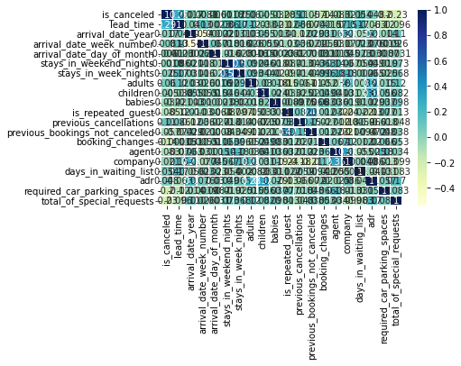
Correlation visualization
It is used to determine change one variable is it affect another variable.It will be ranging from -1 to +1

Slide 5
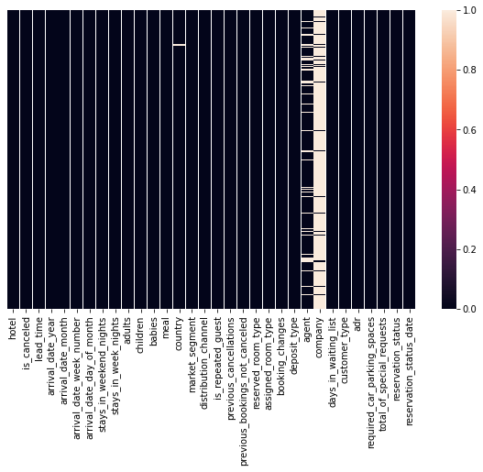
Heatmap (NULL DATA VISUALIZATION)
While checking the null values for the features ,we have got
Features null values
Children 4
Country 488
Agent 16340 company 112593
Remaining features 0

Slide 6
Inference for the above data
First,we have the correlated the features of the dataset in order to get the relationship between the features.
Then we have checked the null-values of all features and we had observed that the feature named ‘company’ has high null values.So,we can drop that company feature from the dataset.
For the remaining features which consists of null values,they will be replacing with median/mode/mean of that remaining non–null data in that feature.

Slide 7
data Preprocessing
Our data contains different types of datatypes. In order to bring to the single datatype we use label encoder.
By fit_transform, we can get all the features to a same datatype.
Without datapreprocessing we cannot proceed to nextstep,It will be difficult
to apply machine learning algoritms on the dataset.

Slide 8
Splitting the data
We will be using two variables X and Y
Y with only ‘is canceled’ feature and X with the remaining features
Next step is to split the X into train data and test data with testdata size : 0.4
Similarly,Y is split into train data and test data with testdata size : 0.4

Slide 9
Accuracy check for different algorithms
For accuracy we will be using different classifiers which we have imported from scikit libraries.
First,we have used logistic regression got test accuracy score and train accuracy score around 0.989.
Then we have gone through several classifiers in order to improve the accuracy score than the logistic regression.
The accuracy score for the decision tree is 100% and we will be decision tree classifier in our model.

Slide 10
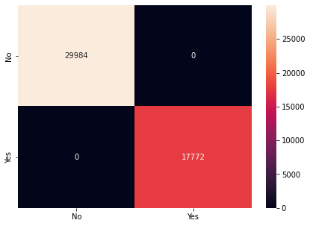
Confusion matrix for decision tree

Slide 11
conclusion
It breaks down a dataset into smaller and smaller subsets while at the same time an associated decision tree is incrementally developed.
Here we have used the criterion ‘gini’ and max depth 3.
Thus,By accuracy score and confusion matrix we can conclude that decision tree classifier is the best.

